Slide 1

STOCHASTIC
RSI

Slide 2

Introduction
A momentum Indicator.
Comparison for Technical Analysis.
Lagging Indicator (An Oscillator).
Identify the 2 Extreme Regions.
Notes:
A momentum indicator, comparing particular closing evaluation of a security to a range of its evaluations over a certain period of time.
Lagging indicator, acts as an Oscillator.

Slide 3
Structure
%K Line
%D Line
A FAST moving line.
Formula:
%K = ((C - L14) / (H14 - L14)) * 100
C = The most recent closing price
L14 = The lowest price traded of the 14 previous sessions
H14 = The highest price traded during the same 14 - day period
The current value of the stochastic indicator
A SLOW moving factor
Formula:
%D is a three period moving average of the %K

Slide 4
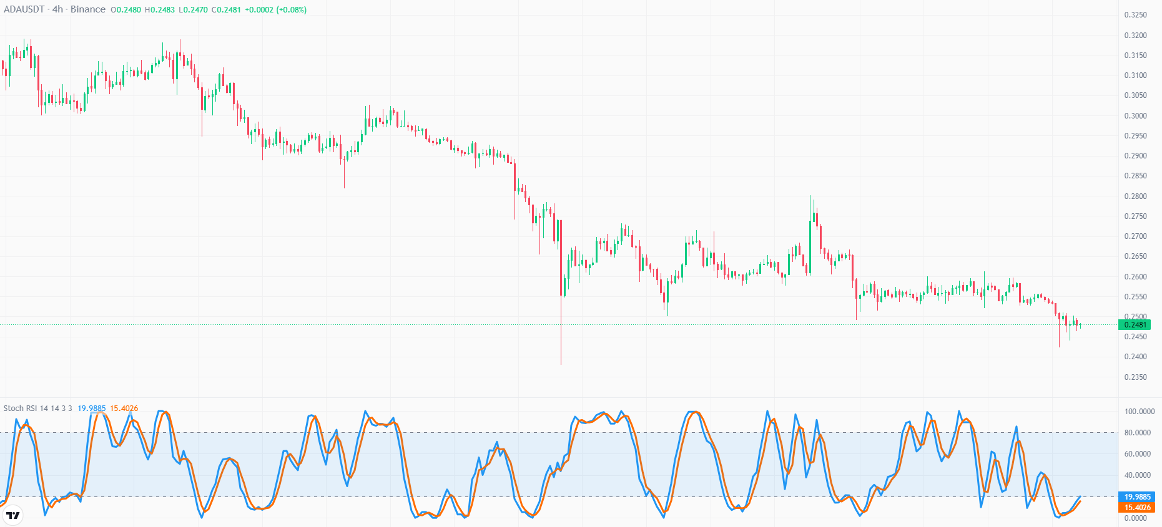
Structure
%D Line
%K Line

Slide 5
Primary Strategies - 1
Entry and Exit Zones:
When the fast moving line crosses the slow moving line from down to up, then it is in the oversold zone and vice versa.
Warning: Wouldn’t see the whole trend but it will mark entry and exit.

Slide 6
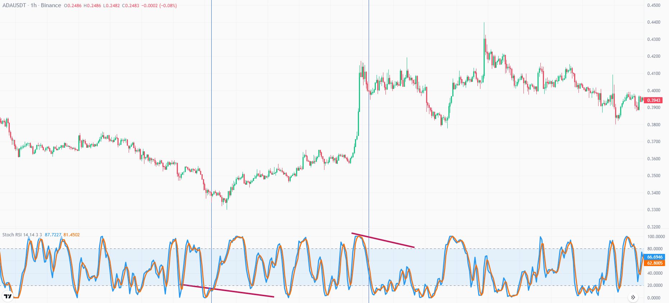
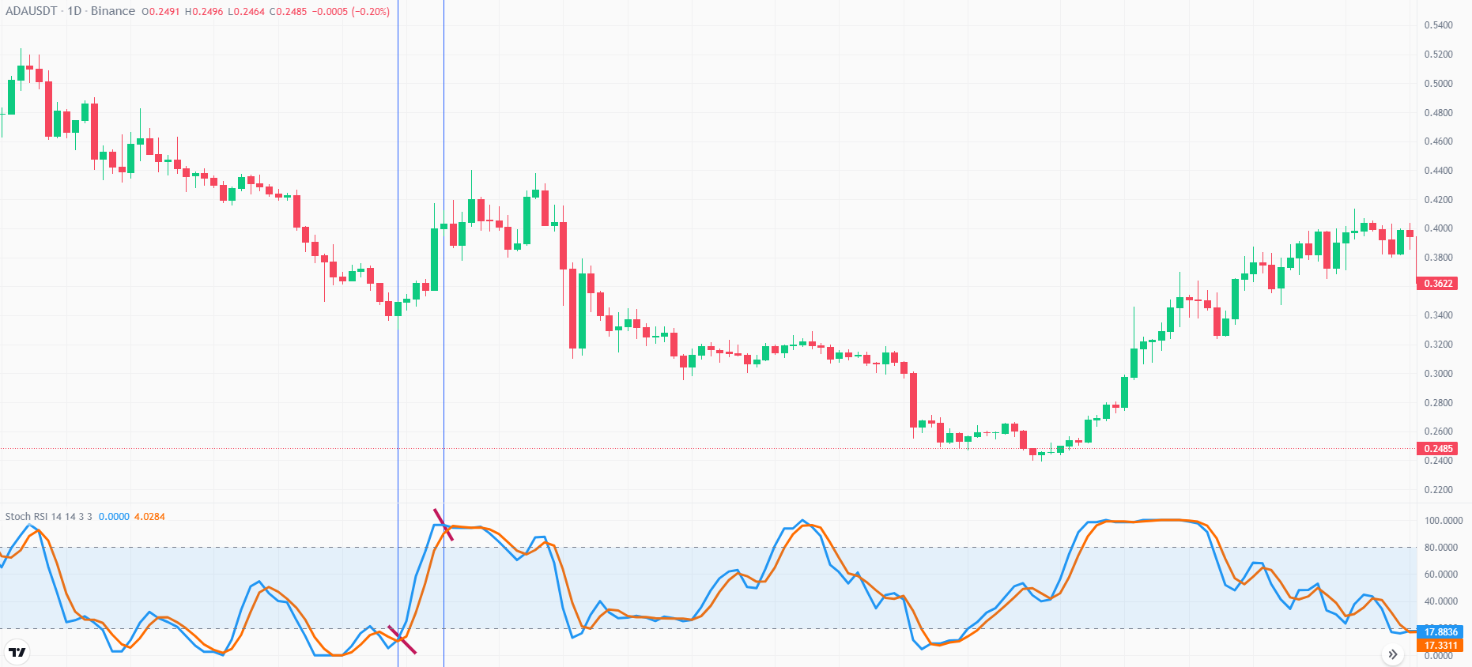
Primary Strategies -2
2) Multiple Time Frames:
1 DAY
1 HOUR

Slide 7
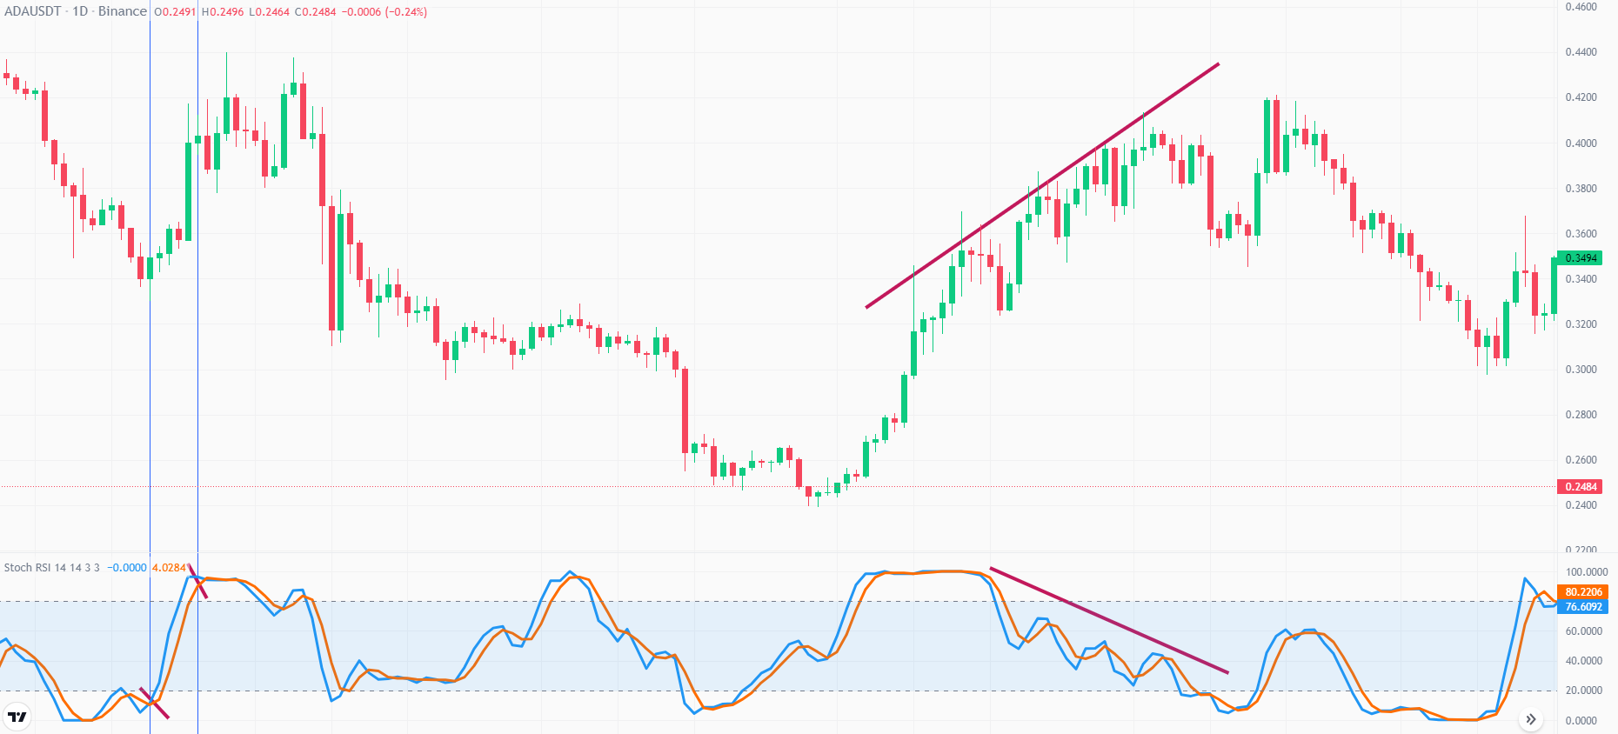
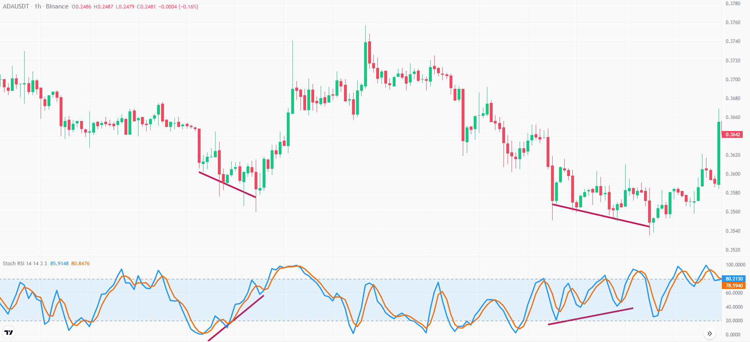
Primary Strategies - 3
Bearish Divergence
Asset Value → HHs
RSI → LHs
Bullish Divergence
Asset Value → LLs
RSI → HLS
Guess What?
Now Look at this

Slide 8
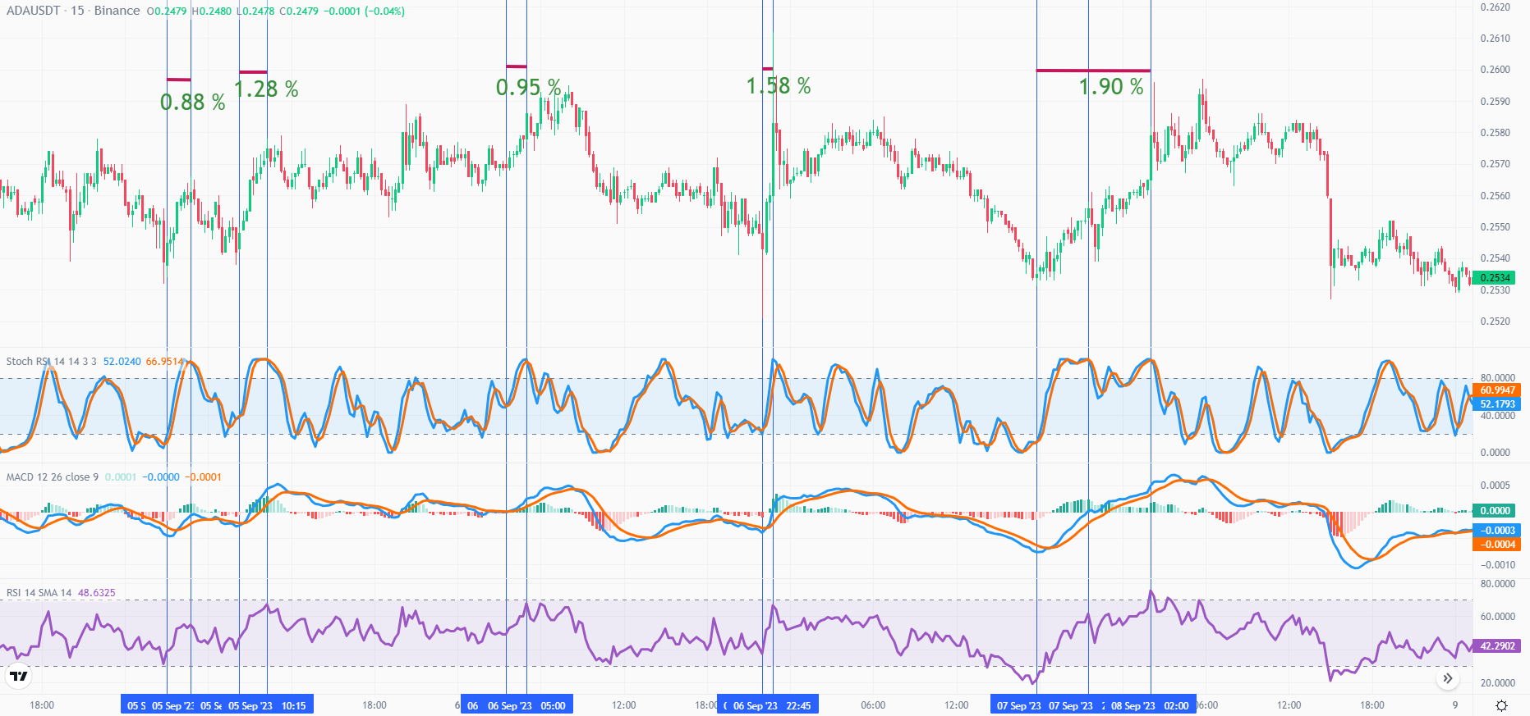
Primary Strategies
From 5 Sept. to 8th Sept.
4) Stochastic RSI + MACD + RSI

Slide 9


Slide 10
Trend Line
An imaginary straight line.
Connects two or more price points and extends into future.
Support and Resistance.
Note:
The more points used to draw the trend line, the more valid it will be.

Slide 11
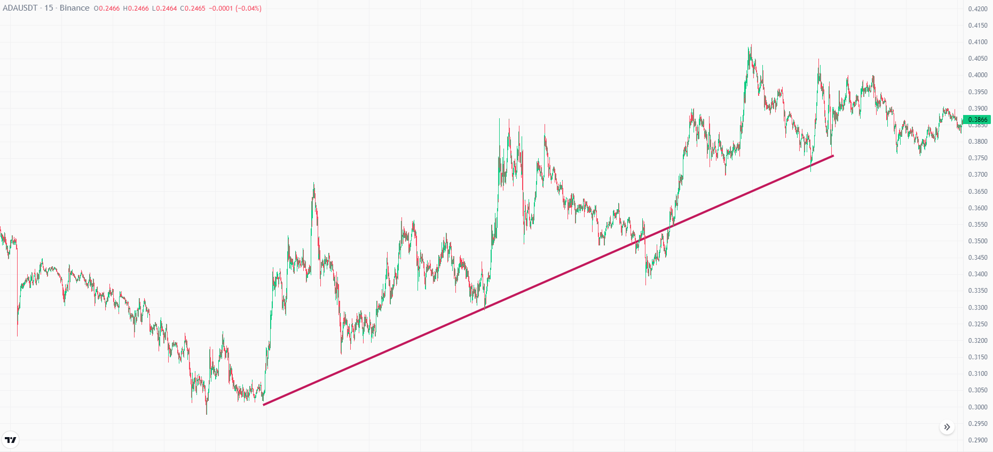
Trend Identification
Up Trend → Focus on HL

Slide 12
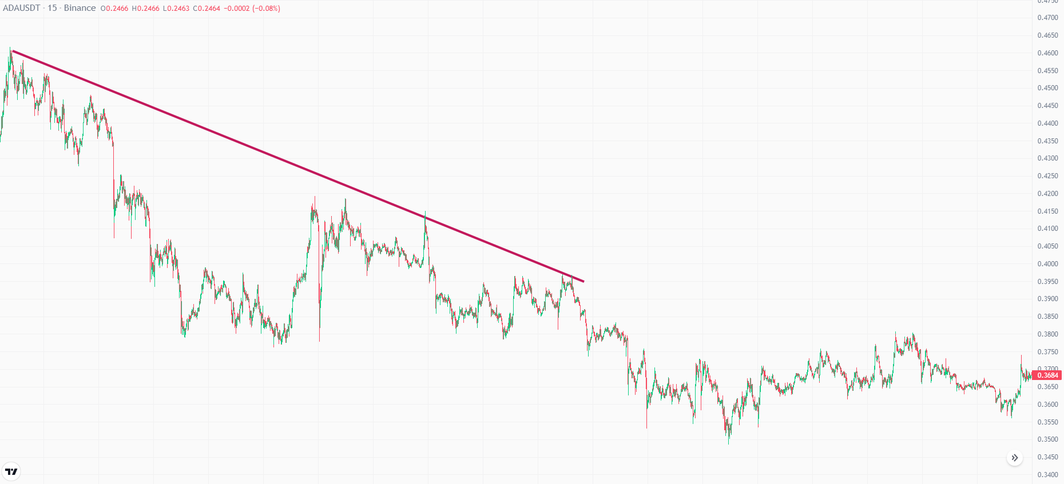
Trend Identification
Down Trend → Focus on Lower Highs

Slide 13
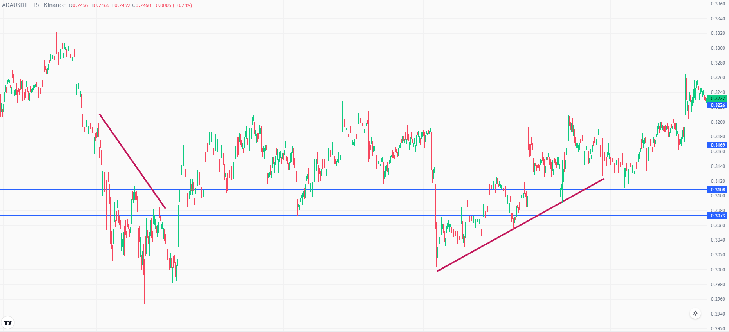
Trend Identification
Side Trend

Slide 14
